Slide 1
Unreliable Narrator

Slide 2
What is it?
When the reader limits or alters information, keeping it from the audience.
The reader needs to be able to tell that what the narrator describes may not be completely accurate.
Remember, the unreliable narrator lies in some way to the AUDIENCE, not just to other characters.

Slide 3
Lies to the audience
Often, we will see characters who lie to other characters. However, in order to recognize it, the author must allow the audience in on the secret.
This is not an unreliable narrator.

Slide 4
Examples
Read the short story “The Tell Tale Heart”
In what ways is the narrator unreliable?
How does the author make it clear that you should not wholly trust the narrator’s story as it is told?

Slide 5
The “Child”
The “Child” is a narrator whose perception is immature or limited through their point-of-view. The might, quite literally, be a child – or simply naïve.
Ex) Charlie Gordon, “Flowers for Algernon” Forrest Gump, Forrest Gump Huck Finn, The Adventures of Huckleberry Finn Scout Finch, To Kill a Mockingbird

Slide 6
Lilo, Lilo and Stitch

Slide 7
The Embellisher
The Embellisher is a narrator who capitalizes on the “little white lie” – stories that enhance the true details of their story. In this case, their lies are good-natured; readers like The Embellisher. Their “lies” are meant to add fantasy or fun, rather than hide from their audience.
Ex) Pi Patel, The Life of Pi Ted Mosby, How I Met Your Mother

Slide 8
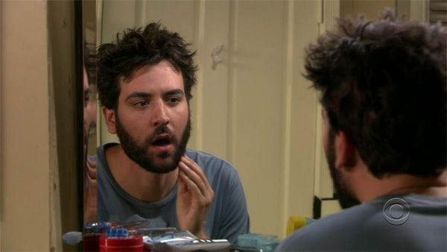
Ted Mosby, How I Met Your Mother

Slide 9
The Liar
The Liar is a narrator who deliberately misrepresents his/herself. Some lie simply to “mess” with their reader, while others mean to obscure their unseemly or discreditable past conduct.
Ex) Emperor Kuzco, The Emperor’s New Groove Gabriel, Supernatural The Joker, Batman

Slide 10
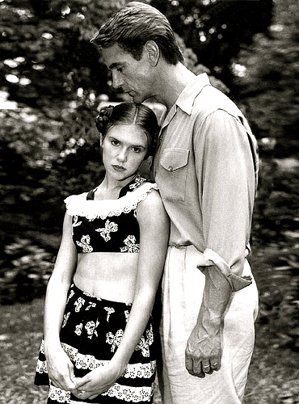
Humbert Humbert, Lolita

Slide 11
The Madman
The Madman is a narrator who is experiencing mental defense mechanisms or severe mental illness, such as paranoia, post-traumatic stress disorder, or schizophrenia.
Ex) Charlie, The Perks of Being a Wallflower John Nash, A Beautiful Mind Teddy Daniels, Shutter Island The Narrator, Fight Club The Narrator, “The Tell-Tale Heart” The Narrator, “The Yellow Wallpaper”

Slide 12
Riggon Thomson, Birdman

Slide 13
The Outsider
The Outsider is a narrator that tells a story from an “outside” perspective. He or she might be telling another person’s story, for example, or the narrator might simply be missing some of the facts. Because of their “outside” perspective, The Outsider is often biased in their narration.
Ex) Elizabeth Bennet, Pride and Prejudice Nick Carraway, The Great Gatsby

Slide 14
Dr. Malcolm Crowe, The Sixth Sense

Slide 15
Practice
Consider the following details:
A 30 year old man, Frank, hears yelling, a loud boom and then quiet. A little while later, he then sees his 25 year old neighbor, Arnold, in the back yard, carrying something large. He calls the cops, saying that he fears his neighbor has done something to his wife or child. When the cop shows up, the man is holding his 6 year old daughter, Ophelia, who is crying. He says that everything is fine and that his wife and daughter both have come down with a terrible case of the flu, and they had been arguing over how to best help them; she didn’t want to go to the doctor. When asked, he says that he was taking the trash to the compactor in the backyard. The wife is not seen or heard.
Do you believe him? Why or why not?

Slide 16
Unreliable narrators
Based on the scenario given, write down some thoughts and feelings that each of the following characters may have:
1. The neighbor, Frank
2. The husband, Arnold
3.The child, Ophelia
4.The cop

Slide 17
Unreliable Narrator
Choose one of the following, and write a short piece from their perspective.
The child's perspective if she saw her father kill her mother (the child)
The nieghbor's perspective if he is crazy and paranoid (the madman)
The husband’s perspective if he killed his wife and he is trying to hide it. (liar)
The cop who is objective but missing information (the outsider)

