Slide 1
Let’s Get Real
Shifting to realistic protagonists and antagonists

Slide 2
Who is this person? Who might be a villain for her?

Slide 3
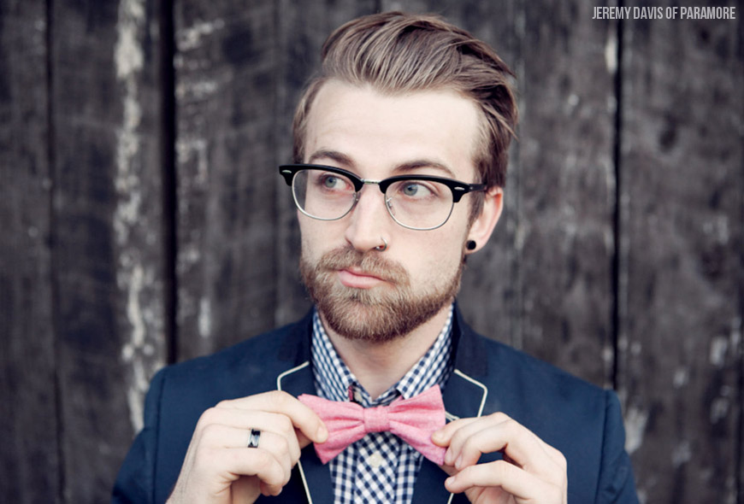
Who is this person? Who might be his villain?

Slide 4
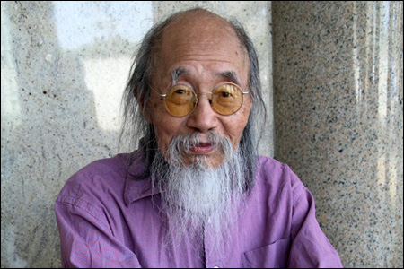
Who is this person? Who might be his villain?

Slide 5
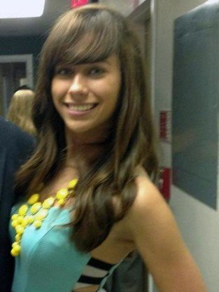
Who is this person? Who might be his villain?

Slide 6
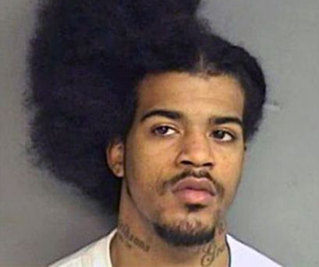
Who is this person? Who might be his villain?

Slide 7
Who is this person? Who might be his villain?

Slide 8
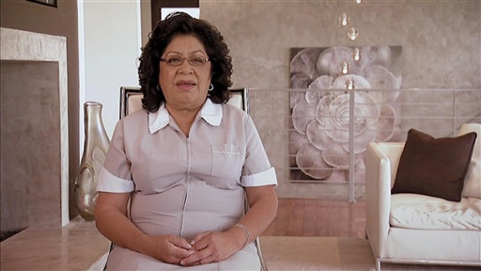
Who is this person? Who might be her villain?

Slide 9
Your Assignment
Create a “realistic” character (no superheroes or fantasy characters) and their villainous counterparts
Provide the basic information, as well as each of their motivations, and an outline for their conflict.
You will be creating a scene between these two characters, so the more you think of now the easier it will be.

