Slide 1
Africa: What do you know?
Objective: SWBAT discuss share knowledge about the countries, people, and history of Africa by accessing prior knowledge and searching the internet to validate and ad to their findings.

Slide 2
KW
Make a chart:
Complete this chart with information about Africa.
Know | Want to Know

Slide 3
Get Visual—contemporary Africa
Draw a picture of Africa. Label all the countries you know. If you know the name of the country, but don’t know its geographical location. List it to the side of your map.
Name any political figures you know from Africa (Name and country if possible).
Famous African writers—name and country
Artists—name and country.
Languages—how many languages are spoken on the African continent? Name any? Where are they spoken?

Slide 4
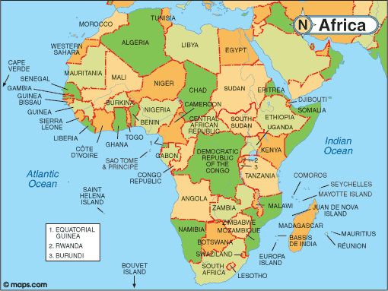

Slide 5
Assumptions
As we look at the following images, I want you to write down the following:
What do you assume about these people? What is the basis of your assumptions?
Do you think you have anything in common with these people? If so, what? If not, why not?

Slide 6
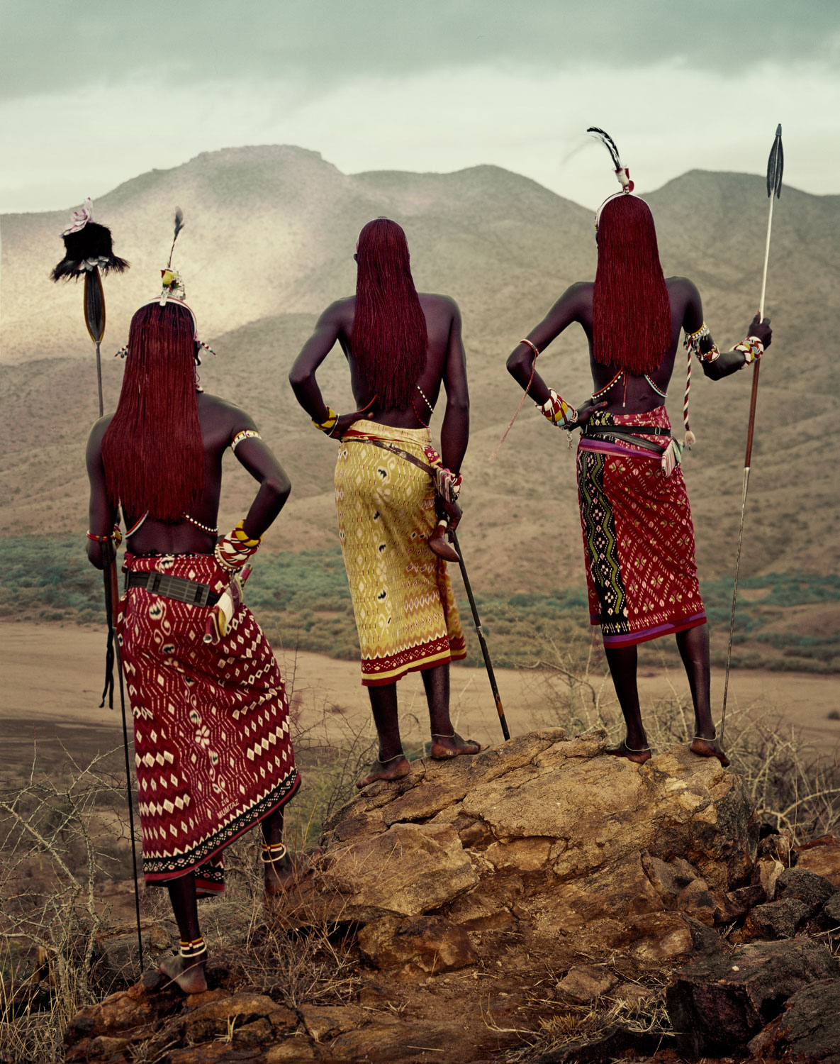
http://www.beforethey.com/tribe/samburu

Slide 7
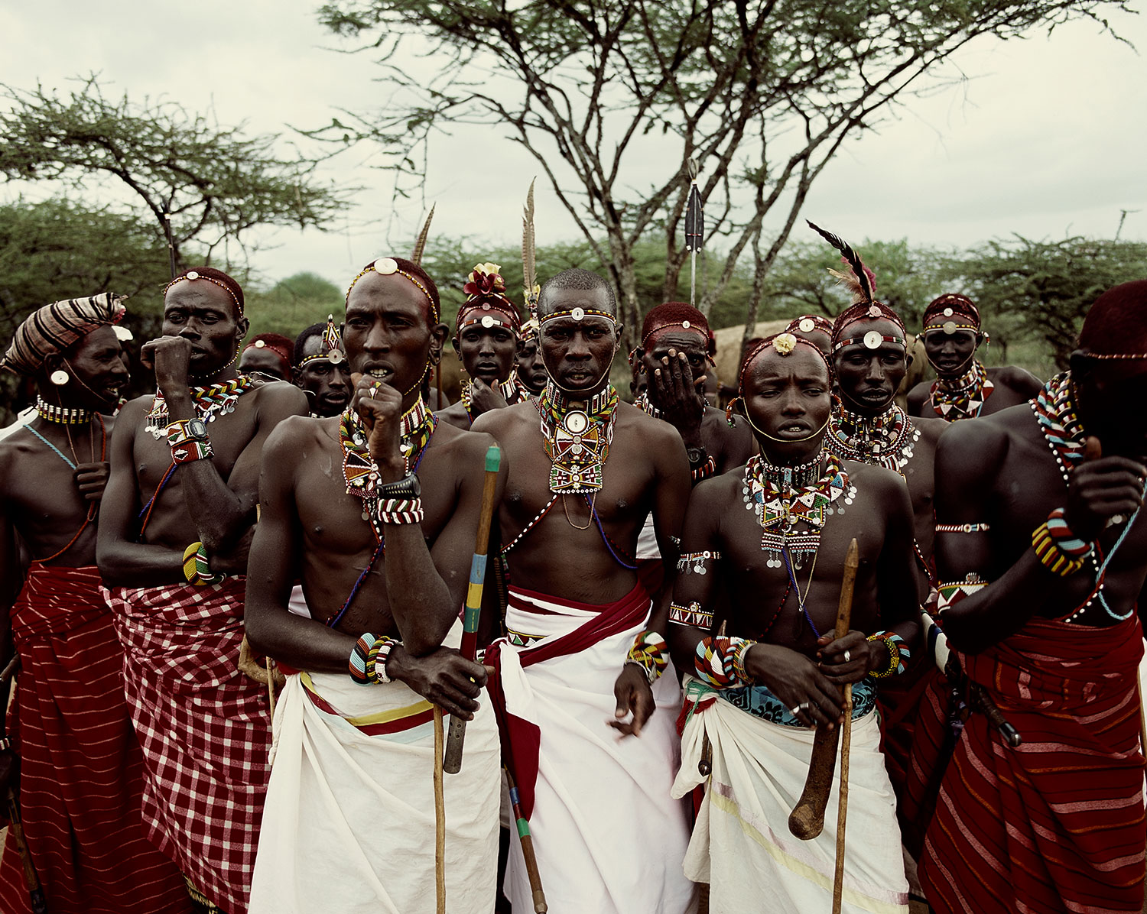

Slide 8
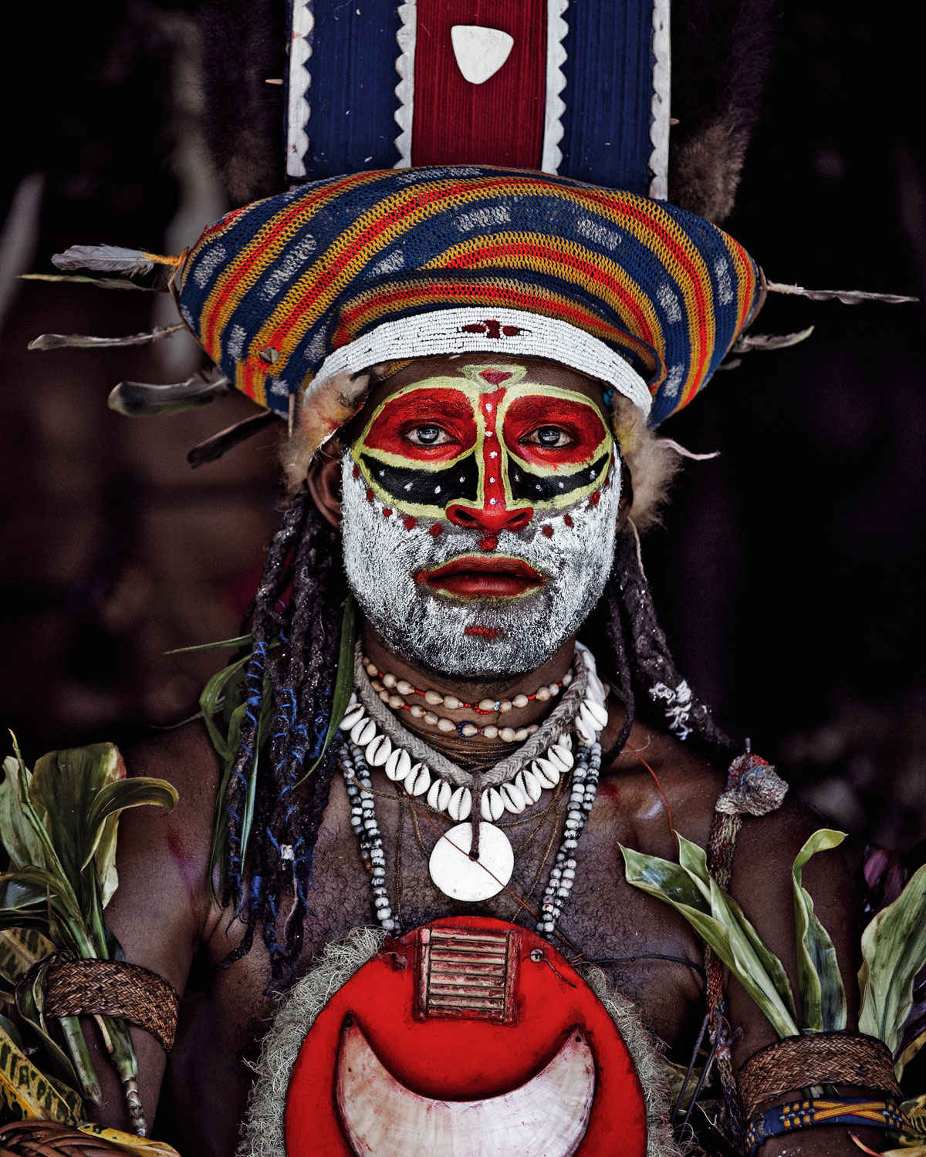

Slide 9
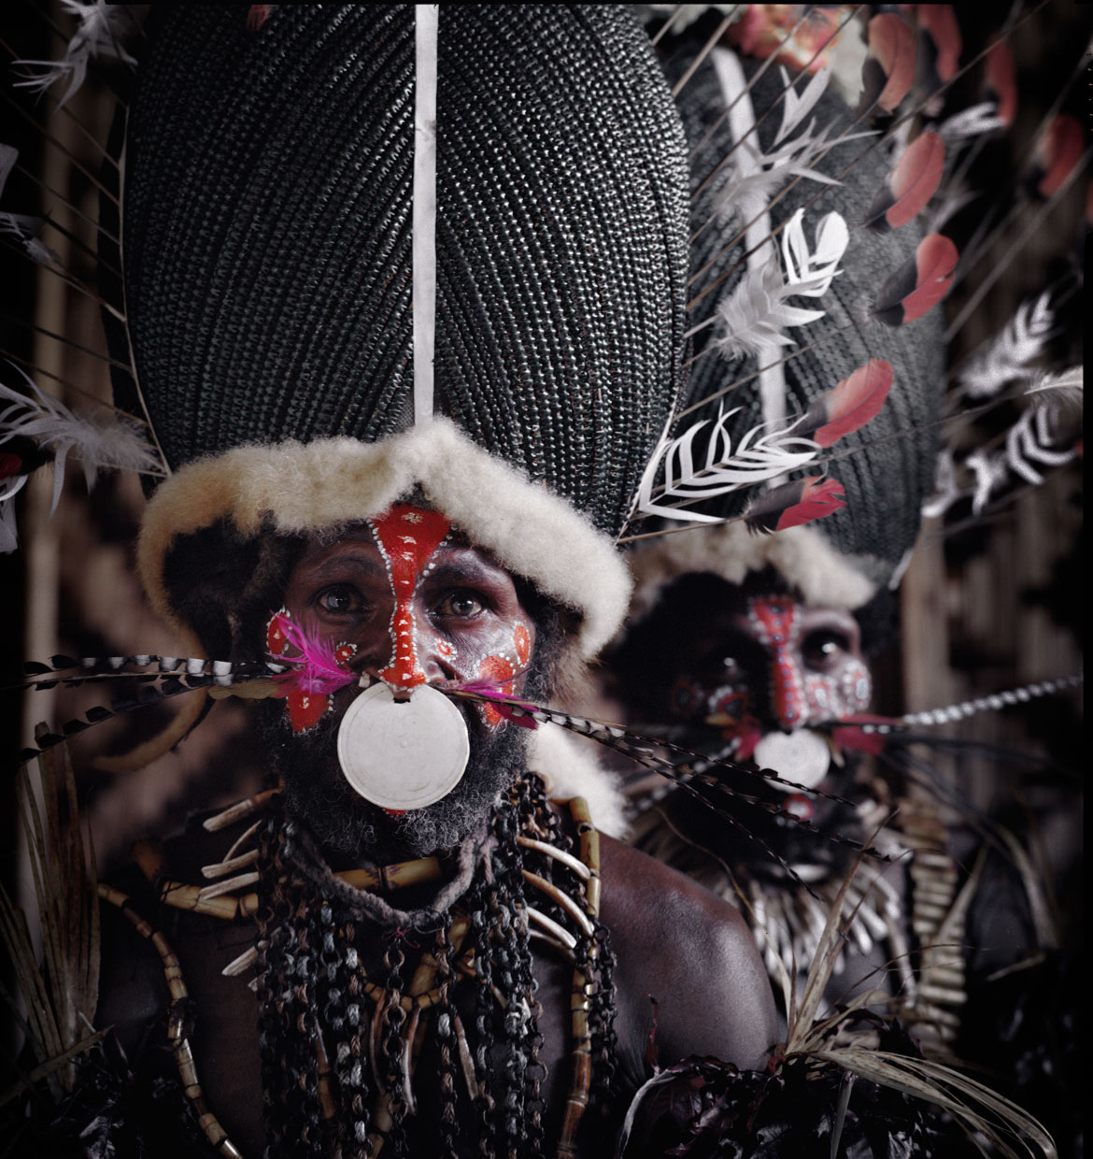

Slide 10
Reflection
What thoughts and feelings did you have when looking at these pictures?
Do you consider these people “primitive”? Why or why not?
Do you think you have anything in common with them? If so, what? If not, why not?

Slide 11
White Man’s Burden
Read the poem and answer the questions that follow.
Then, we will review it together.

Slide 12
Heart of Darkness Excerpt
Read and annotate the excerpt.
What is the main idea of the passage?
Examine the language used to describe the natives. How does this narrator seem to feel about the people he encounters? How does he view them?

Slide 13
Begin Reading Chapter 1
We will begin reading the book aloud, and stopping to discuss where you have questions.
As we read, fill in details on your book mark so that you can keep track of the characters and places in the book.
The names are confusing! Use the book mark to help keep them straight.

Slide 14
Anticipation Guide
For each statement, check the box under “Agree” or “Disagree” and give a brief explanation for why you chose your answer.
You MUST choose one and cannot choose both.

Slide 15
Journal
Somewhere in your notes, write a paragraph where you consider the following:
Imagine aliens were coming to earth for the first time and they arrive at Christmas. How might they view some of our traditions? Do you think they would consider us odd or primitive? Why or why not?

Slide 16
Watch
Dr. Who
What did they get right?
What did they get wrong?
We know that the missionaries are coming to Umuofia. What might they get wrong?

Slide 17
Watch
Why do you think we read this book? What should we learn from it?
Before They Pass Away
Dangers of a single story

Slide 18
White Man’s Burden
Read Kiplings “White Man’s Burden” and annotate.
Then, answer the questions that follow.

Slide 19
White Man’s Burden
1. What is the "White Man's Burden?" Why does Kipling regard this as a burden? 2. At the end of the second stanza, Kipling writes "To seek another's profit, and work another's gain." What does this imply about his views of imperialism? Is he correct in this assertion? 3. How does Kipling view those being imperialized? Is he correct in this assumption? Why did many Westerners hold the same belief as Kipling? 4. At the end, Kipling writes (or implies) that those doing the imperializing will most likely not receive any thanks from those who are benefiting (the imperialized nation) and will face the judgment of their peers. If that is the case, why would someone engage in imperialism? The next few questions ask you to think hypothetically about imperialism in general. 5. Is imperialism always done for the benefit of the mother country? Why or why not? Cite specific historical examples. 6. Can imperialism be done in a manner that is truly altruistic? (By that, I mean, can one engage in imperialism solely for the benefit of the nation being imperialized?) 7. What are the pros and cons of imperialism? Do the cons outweigh the pros

Slide 20
Reflection
In what ways do we have a single story of Africa?
Why do you think that could be dangerous?

Slide 21
Listen:
https://www.youtube.com/watch?v=CTgj_myK3qk

Slide 22
Chinua Achebe’s Obituary
Read and annotate his obituary.
When annotating, look for Achebe’s reasons for writing.

Slide 23
Chinua Achebe’s Obituary
With your table mates, create a master list of Achebe’s motivations.
We will share out. As each group shares their list, everyone should be listening and either question the relevance of the motivation, or add it to your own list.
I will write our master list on the board as we go.

Slide 24
Purpose for Writing
Each group will be assigned one of the motivations for writing. Your group will be in charge of finding examples to support your group’s purpose as you read Things Fall Apart.

Slide 25
Read Chapters 1-3
Answer the following questions as you read.
1. What is your general impression of Okonkwo (family man, community member, friend)? Be specific: son, father, husband, and friend?
2. Who is the narrator? The narrator claims that Okonkwo is ruled by his fear of his own weakness and failure. In what way do these fears play out in Okonkwo’s life and his treatment of others?
3. Read the last paragraph of chapter 1. How is the last sentence an example of foreshadowing?

Slide 26
Foreshadowing Paragraph
At the end of Chapter 1, why does Achebe use the words “doomed,” “sacrificed”, and “ill-fated”?
Is Achebe’s language too heavy-handed? Why or why not?
Write a paragraph explaining how this foreshadowing functions in the text.

