Slide 1
Chart
After viewing the following painting, fill in the chart.
What | How | Why
What elements do you see in the painting? | How has the author portrayed/conveyed that particular element of the painting? | Why do you think the painter included the element, and in that manner?

Slide 2
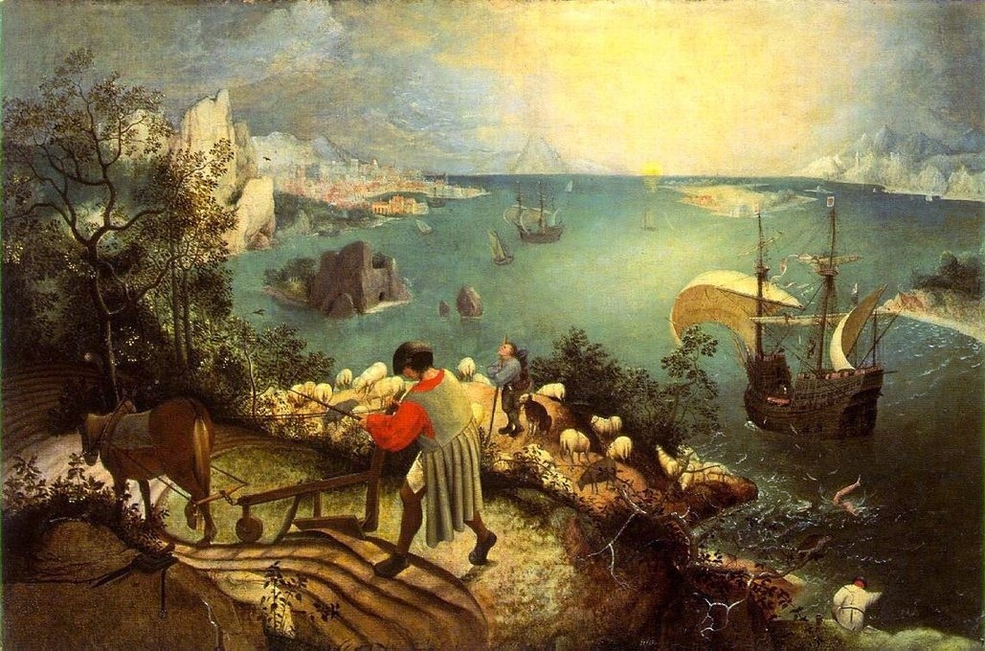

Slide 3
Title
This painting is called the “Fall of Icarus”.
Now that you know the title of the painting, go back to the details that you have listed and re-evaluate your “why” column.
Why do you think he named the painting “Fall of Icarus” and why do you think he included the various elements and styles?

Slide 4
Poems
Many poets have written about Icarus, and some about this very painting.
In groups, read your assigned poem and consider:
1) What is the poet’s attitude toward Icarus?
2) What message/theme does the poet express?
3) How does the author’s language, structure, and other poetic devices reveal and support that theme?

