Slide 1
Dialogue and Paragraph Breaks

Slide 2
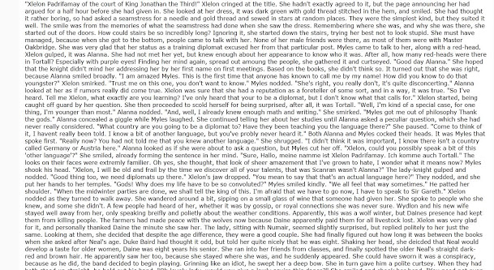
How do you feel when you open a book and see this:

Slide 3
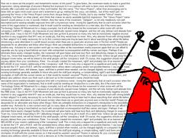
Probably something like this…

Slide 4
So why do you as a writer of fiction need to worry about when to start a new paragraph?
The function of paragraphs
Paragraphs help your readers to follow your story without becoming confused. Paragraphs provide a structure and make reading easier by grouping sentences that belong together and separating sentences that don’t belong together.
Also, using paragraphs creates white space on the page, and that’s something modern readers like. If you have ever come across a text with no or few paragraph breaks, you know how intimidating long, unstructured blocks of text can look.

Slide 5
So…When do you start a new paragraph?
What do you think? Take a moment and fill in some reasons you use to start a new paragraph.

Slide 6
Reason 1: Dialogue and New Speaker
Any time you have a new speaker, you should have a new paragraph.
“I knew it wouldn’t last.” Miles shakes his head and gazes at Damen…”I knew it was too good to be true. In fact, I said exactly that the very first day. Remember when I said that?”
“No,” Haven mumbles, still staring at Damen. “I don’t remember that at all.”
“Well, I did.” Miles swigs his Vitamin water and nods. “I said it. You just didn’t hear me.”

Slide 7
Reason 1 (cont)
Remember, that the other person might respond non-verbally or with an action.
“Are you angry with me?” Jill asked.
Tina glared at her.
“Oh, come on. Don’t give me the cold shoulder.”
“Leave me alone” Tina replied, storming off.

Slide 8
Reason 1 (cont)
Notice that this means you do not have to have dialogue tags in every line.
Readers can keep track of who’s talking because every new speaker has a paragraph of its own.

Slide 9
Reason 2: New topic=New paragraph
You should create a new paragraph to indicate changes in tone or topic.
I can feel Damen’s gaze—heave, warm, and inviting, and it makes me so nervous my palms start to sweat and my water bottle slips from my grip. Falling so fast, I can’t even stop it, all I can do is wait for the splash.
But before it can even hit the table, Damen’s already caught it and returned it to me. And I sit there, starting at the bottle and avoiding his gaze, wondering if I’m the only one who noticed how he moved so fast he actually blurred.
Then Miles asks about New York, and Haven scoots so close she’s practically sitting on Damen’s lap, and I take a deep breath, finish my lunch, and convince myself I imagined it.

Slide 10
Reason #3: Emphasis
You can change paragraph to add emphasis or suspense to the line.
This is the ubiquitous single line that is found throughout contemporary writing.
I mean, I have all the usual things like a bed, a dresser, and a desk. But I also have a flat-screen TV, a massive walk-in closet, a huge bathroom with a Jacuzzi tub, and separate shower stall, a balcony with an amazing ocean view, and my own private den/game room with yet another flat-screen TV, a wet bar, microwave, mini fridge, dishwasher, stereo, couches, tables, bean bag chairs, the works.
It’s funny how before I would’ve given anything for a room like this.
But now, I’d give anything just to go back to before.

Slide 11
Reason #4: Moving Forward or Backward in Time
Start a new paragraph when you move forward or backward in time. Of course, that might also be a good reason to start a new scene.
Example:
“Give me a few minutes to get changed, then meet me in the kitchen,” Tina said.
Jill nodded and went back to her book.
Half an hour later, Jill still hadn’t joined Tina in the kitchen.

Slide 12
Practice
I have typed up a passage from the YA novel Evermore, BUT I have taken out all of the paragraph breaks that the author used.
Your job is to go through the passage and write at the beginning of each word where you think there should be a new paragraph.

