Slide 1
A Doll’s House

Slide 2
Journaling…
Please take out a sheet of paper.
Take 5 minutes to journal on the following topic:
Journal Prompt
Describe the role of women in today’s society.
What is the perfect woman supposed to be like?
What is the perfect man supposed to be like?
Dig Deep!
We will discuss this as a group at the end of 5 minutes.
You should be writing the entire time and should have at least 5 complete, thoughtful sentences!

Slide 3
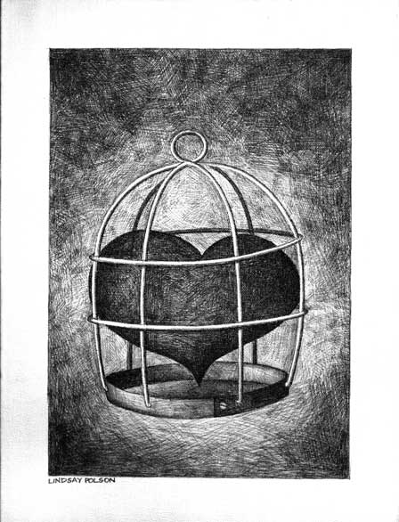
Big Questions
These are the Questions that Will Guide Our Entire Unit:
In what ways are we trapped in our lives?
Do we choose to be trapped?
Try to answer these questions now, at the beginning
of the unit.

Slide 4
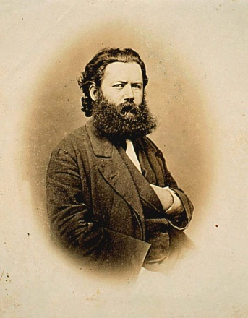
Henrik Ibsen 1828-1906 Biographical Influences
Born in a tiny coastal town in the south of Norway
Merchant father went bankrupt – raised in poverty.
Mother was a painter and loved theatre.
Age 18 –supported his illegitimate child through journalism
Failed his entrance exam to the university where he had hoped to become a physician.
What makes him so special?
He was one of the first writers to use REALISM.

Slide 5
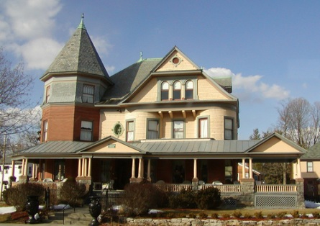
Realism in A Doll’s House
What does this really mean?
Realism: Literary technique that attempts to create the appearance of life as it is actually experienced
Common Language, NOT highly poetic language formal declarations, asides, or soliloquies
Everyday people and events, NO heroes or the saving a kingdom.
Opening of the eyes and the minds of an audience, NOT melodrama with happy endings.

Slide 6
THE VICTORIAN ERA Europe: 1837-1901 (1879)
How do these women, their relationships / marriages compare to ours today?

Slide 7
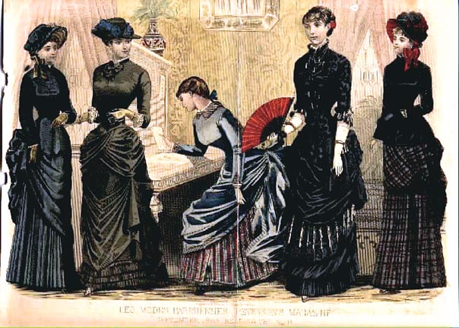
THE VICTORIAN ERA Europe: 1837-1901 (1879)
Based upon this image, what assumptions do you have about women in this time period?

Slide 8
Images of Victorian Women vs. the Women of Today
Sex appeal in the Victorian Era was heavily frowned upon.
When in view of others, women were to have every inch of their bodies covered at all times.
It was socially unacceptable to let any excess skin show because it was considered risqué (provocative).
Modesty was considered attractive!
Modesty: to make yourself look like you are less impressive, to not offend others

Slide 9
Images of Victorian Women Vs. The Women of Today!
In your notes, write down how you think the two time periods compare

Slide 10
One Rule of Modesty (Etiquette)
A lady, when crossing the street, must raise her dress a bit above the ankle while holding the folds of her gown together in her right hand and drawing them toward the right.
It was considered vulgar to raise the dress with both hands as it would show too much ankle, but was tolerated for a moment when the mud is very deep, as told by The Lady's Guide to Perfect Gentility.

Slide 11
Women’s Rights in the Victorian Era (and the lack thereof)
Women had few rights in the Victorian Era.
Women could not own land, vote, or take out a loan.
Women were forced to be obedient to their husbands.
They had few job opportunities.

Slide 12
Victorian Marriage: The Ultimate Goal
Few marriages began with Love.
Most marriages were out of social obligation or necessity.
They were usually arranged by the families or sought out for financial security.
Many were considered “business deals” and rarely began out of love.

Slide 13
The Realities of Marriage: Victorian Era
Rules, Rules, Rules, Rules…
Most girls married between the ages of 18 and 23, especially in the upper class.
Marriage was encouraged only within one’s class. To marry up was almost impossible and to marry down was considered foolish and beneath oneself.
The wife was expected to provide a dowry (financial enticement to marry her).
A man must provide a way of life that his wife has been accustomed.
All of a wife’s possessions now belong to her husband.

Slide 14
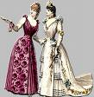
Female Etiquette: The Rules Women Must Follow
She never approached people of higher rank, unless being introduced by a mutual friend.
A single woman never addressed a gentleman without an introduction.
A single woman never walked out alone. Her chaperone had to be older and preferably married.
If she had progressed to the stage of courtship in which she walked out with a gentleman, they always walked apart. A gentleman could offer his hand over rough spots, the only contact he was allowed with a woman who was not his fiancée.
Proper women never rode alone in a closed carriage with a man who wasn't a relative.

Slide 15
Female Etiquette: The Rules Women Must Follow
She would never call upon an unmarried gentleman at his place of residence.
She couldn't receive a man at home if she was alone. Another family member had to be present in the room.
No impure conversations were held in front of single women.
No sexual contact was allowed before marriage. Innocence was demanded by men from girls in his class, and most especially from his future wife.
Intelligence was not encouraged, nor was any interest in politics.

Slide 16
Socially Correct Couples (even down to the physical)
People with eye color of blue, gray, black, or hazel should not marry people with the same eye color.
People with thin, wiry features and "cold blood" should marry those with round features and "warm blood."
Those with bright red hair and a florid complexion have an excitable temper and should marry a person with very dark black hair or possibly a brunette.
Soft, fine haired people should not marry people like themselves.
People with curly hair should marry those with straight hair.
Irritable, nervous people should marry sympathetic, quiet types.
Quick-speaking people should marry someone calm and deliberate.
People who do not fit into one specific category (ie not blonde of brunette) or are average (not tall or short) should marry someone similar to themselves.
Do You Think This Balance Works?

Slide 17
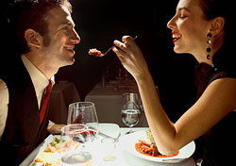
Pair Work
Goal: To create a double-sided presentation displaying the differences between the rules of marriage TODAY, and the rules of marriage in VICTORIAN times.
Try to be as creative as possible!
What rules should the PERFECT husband or wife follow?
What should the consequences be if the rules are broken?
Example → In marriage today, the husband must NEVER order dinner for the wife. He should let her decide what she wants to eat!
YOU WILL HAVE 15 MINUTES
TO FINISH THIS!

Slide 18
Example
Victorian rule | Consequence | Modern rule | Consequence
Woman was supposed to be married by 23 | She was labeled a spinster and would have a much more difficult time ever getting married. | Husband should not order dinner for his wife. | She will be upset, assuming he thinks that she is inferior or incapable.
A woman could not lift her dress up with 2 hands | People would consider her indecent. | Husband and wife should split laundry duties | She will be exhausted and others will consider him lazy

Slide 19
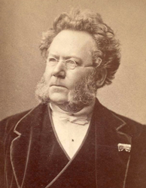
Ibsen’s Controversial Thoughts!
Ibsen felt that, rather than merely live together, husband and wife should live as equals
Women should have freedom to develop as adult, independent, and responsible people

Slide 20
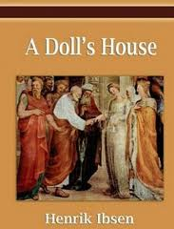
Isben’s Controversial Thoughts
Surprisingly, Isben was NOT a feminist.
He believed that the women were extremely important in taking care of children and their husbands.
HOWEVER, he believed that a woman would not be able to successfully fulfill those roles unless they were treated as equal human beings.

Slide 21
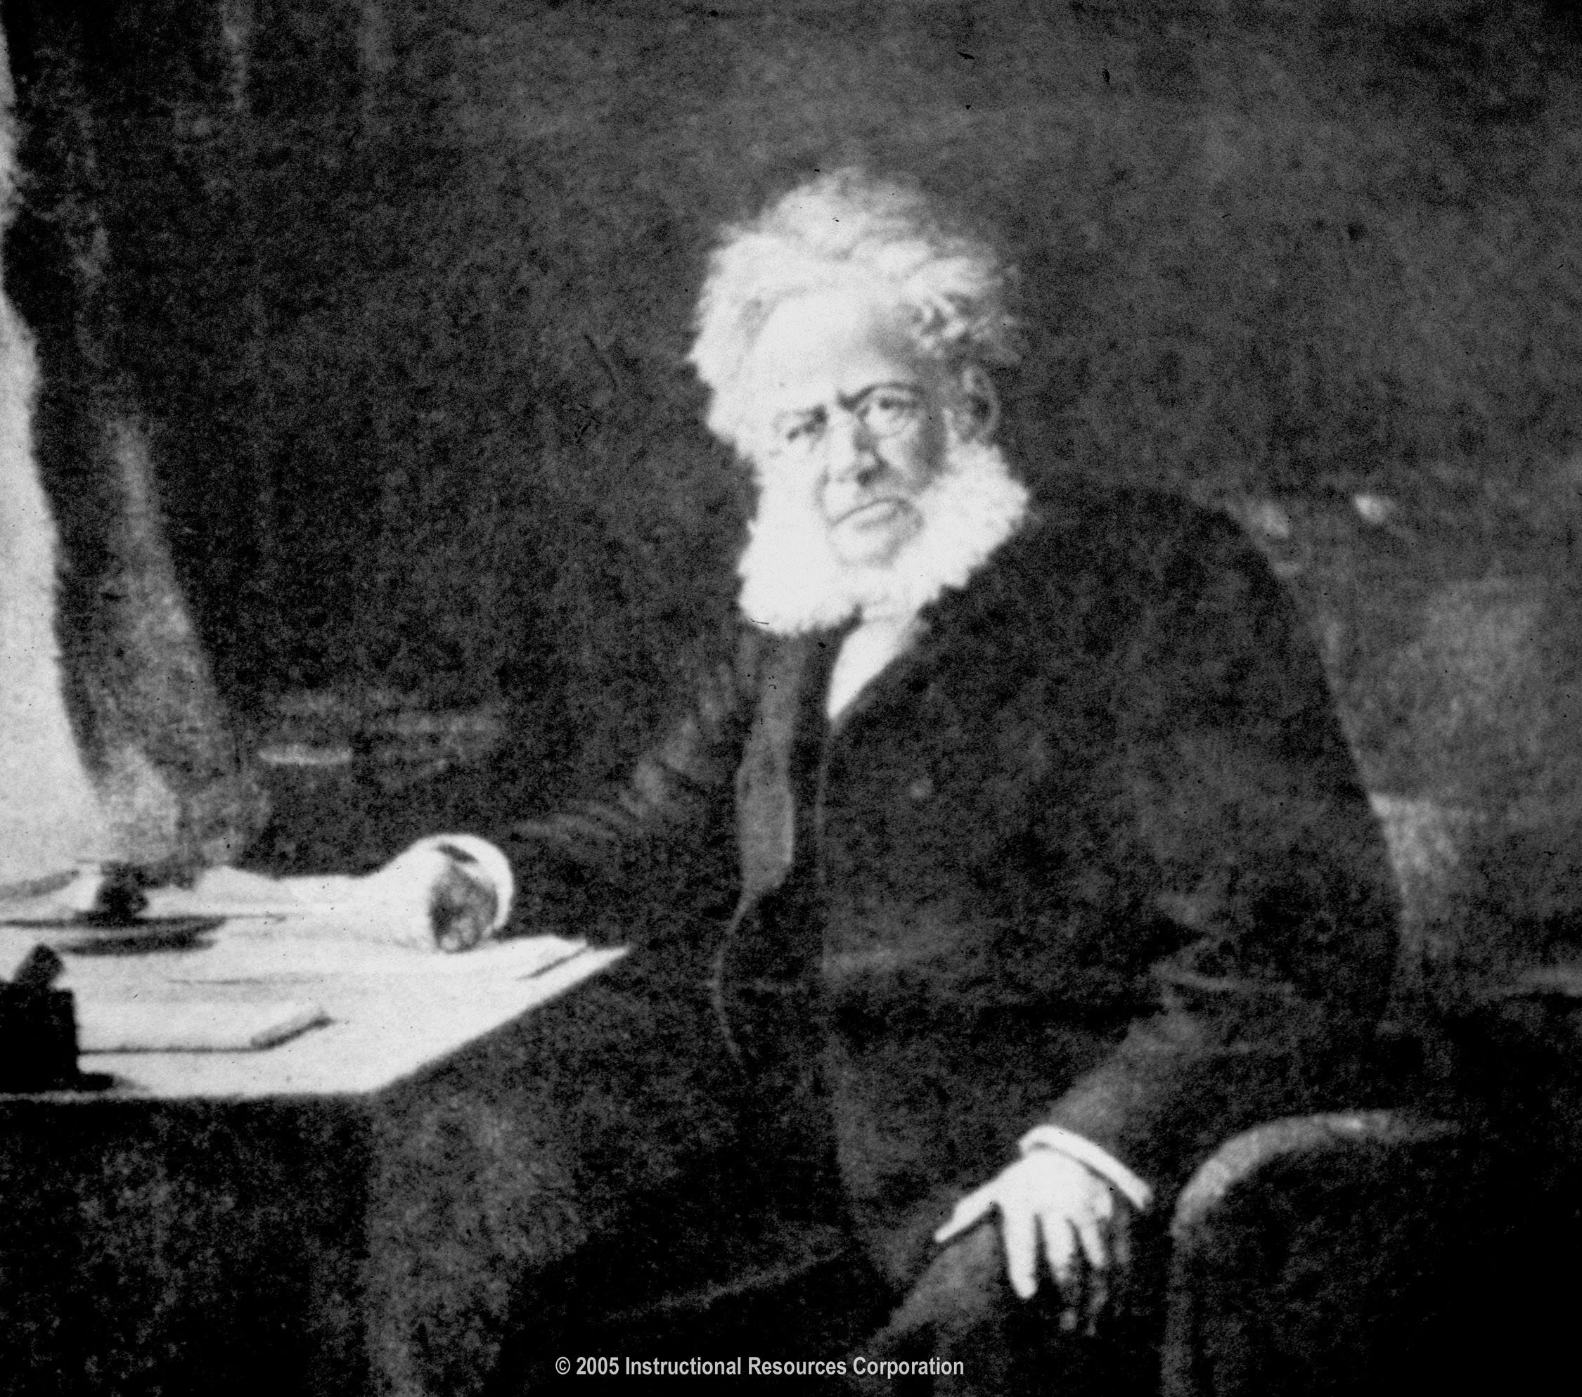
Henrik Isben: A Revolutionary Man
Realist for his society!
“A Doll’s House” centers on
Victorian Controversy!
Letters sent to daughters:
DON’T GO TO THIS PLAY!
“The strongest man in
the world is he who stands
alone.” – Henrik Ibsen
Brace yourself for a drama filled with lies, deceit, and suspense!

Slide 22
Act 1
Assign books
You will be keeping an annotation log while reading this play.
Look for: unknown vocabulary, questions (and possible answers), inferences, connections, and predictions.
Also, keep an eye out for symbolism, characterization, conflict, and theme. (and any other literary device you can think of)
When you recognize these things, ANALYZE THEM. Don’t just identify them.
Ask—”Why is this important?” Or “What could this indicate/reveal?”
As we read aloud, you can raise your hand and we will stop to discuss any aspect of the play.

Slide 23
On a separate sheet of paper, answer the following questions:
Describe a nickname that you have. Think of family, friends, and teachers. How did you get this nickname?
How does it make you feel to hear that nickname?
(If you don’t have one, what is a nickname that you would like to have? Why?)
What are some common terms of endearment that you have heard people call each other?

Slide 24
Denotation vs. Connotation
Denotation:
Literal / Factual Meaning
Dictionary Definition
Connotation:
Emotional Association With The Word
Positive or Negative
What’s the point?
An author’s diction is intentional. Many times, the author is hoping for us to feel a certain way about something and uses words to lead us towards that feeling!

Slide 25
Denotation and Connotation
How can words change how we feel?
Which of the following is more positive?
a) We bought inexpensive souvenirs at the amusement park.
b) We bought cheap souvenirs at the amusement park.
Which of the following is more negative?
Everyone had a smirk on his/her face on the ride home.
Everyone had a smile on his/her face on the ride home.

Slide 26
Connotation Practice!
For the following 10 pairs of words, place one word in the “positive connotation” side of the chart, and the other in the “negative connotation” side of the chart!
1. gaze, stare
2. fragrance, odor
3. brainwash, persuade
4. delayed, tardy
5. nosy, curious
6. lazily, leisurely
7. demand, request
8. crowd, mob
9. slim, skinny
10. debate, argue

Slide 27
Revisiting your Journal
What is the connotation of your childhood nickname?
Does this change the way you feel about your nickname? Why or why not?

Slide 28
Read A Doll’s House: Act 1
The Play starts on page 141
We need someone to read each of the following parts:
Nora
Torvald Helmer (husband)
Maid
Mrs. Linde
Krogstad
Dr. Rank
Children
Nurse
Stage Directions

Slide 29
Annotate while reading
Look especially for:
Characterization
Symbolism
Gender roles
Vocabulary
Anything else that stands out to you
Today, we will be reading aloud, using PAUSE AND PLAY. If you think there is a moment when we should annotate, yell PAUSE. Then we will stop and talk about it.

Slide 30
Wednesday 3/28: Honors
You can continue this warm up on the same sheet that you used yesterday. Answer the following questions.
Describe Nora’s character
Describe Torvald Helmer’s character
How does Mrs. Linde serve as a contrast to Nora?
Who is Krogstad and what does he want from Nora?
How does Torvald feel about Krogstad? Why does he feel this way?

Slide 31
Wednesday: 3/28 Academic
On your sheet from yesterday, and using your notes, answer the following questions.
What were three rules a lady had to live by during the Victorian era?
Name two rules that governed marriage in the Victorian era.
Why was it so important for a woman to get married?
What is realism?

Slide 32
Honors:
SILENTLY, spend 20 minutes answering the ACT 1 questions in your packet.
When the 20 minutes is up, we will have a discussion so that you can complete the second half of the chart.

Slide 33
Small Groups
In groups of 2-4, read and annotate Act 2 of A Doll’s House.
Be prepared to discuss.

Slide 34
Honors 3/29 Warm Up
Answer the following questions:
What does Torvald believe is the effect of Krogstad’s moral illness?
What reason does Torvald give to explain Nora’s inability to handle money?
What might this suggest about the Victorian era?
Put your book reports on your desks so that I can collect them when we are done with the warm up.

Slide 35
Honors: Agenda
Warm up
Time sheets
Act 1 Discussion
Extra credit Assignments to be completed in class.
Option: you may continue reading and annotating instead of doing this extra credit assignment if you like.
Due dates:
You should have read through Act 2 when we come in on Monday.
Your spring break packets are due the Tuesday we come back from break.

Slide 36
Academic Agenda
Warm up
Time sheets
Finish reading Act 1
Extra credit assignment

Slide 37
Honors: Extra Credit Assignments
Quiz grade
In your packet, you have an assignment called “Extra! Extra! Hear All About It!”
Your assignment will be done INDIVIDUALLY!
You will be given a picture of someone who has been trapped in one way or another.
You will then create a WRITTEN news report about how that person came to be trapped. The story can be funny, serious, sad, or scary. You can create whatever story you want, but it should be creative!

Slide 38
Honors Extra Credit
Make sure you answer all of the following questions in order to present the perfect news report.
Who is the person in your picture?
How did this person get trapped?
What events led up to them being trapped?
Were other people involved in the incident?
Where did this happen?
What happened because of the person or people becoming trapped?
Is there any information that we should know about this person or situation?

Slide 39
Monday 4/9 Warm up Honors
Why do you think Nora wants to say “Bloody Hell” to Torvald in Act 1?
Does Nora seem to fulfill the role of the perfect Victorian woman? Why or why not? (Use your notes)
Do you think Torvald is a self-confident person? Why or why not?
What do you think are the major differences between Nora and Mrs. Linde?

Slide 40
Monday 4/9 Warm up: Academic
Answer the following questions in complete sentences
Who is Krogstad and what does he want from Nora?
Describe Mrs. Linde. What kind of person is she?
Why do you think Torvald calls Nora his “little skylark” or “little squanderbird”? How do you think he feels about Nora?

Slide 41
Announcements
Honors: Spring break packets are due tomorrow! Be prepared to participate in our Socratic seminar.
Honors and Academic: Get yourself a new independent reading book by Wednesday.

Slide 42
Return papers
I’ve got lots of stuff to give back to you!
Formative final grade=
0.8*(essay grade)+0.2*(grammar grade)

Slide 43
Academic Agenda
Today, we will finish reading Act 1 and we will view the film version of Act 1.
At the end of the period, you should have your questions for ACT 1 finished.
Tomorrow, we will read and discuss Act 2.

Slide 44
Brief Review
In Act 1-2 of A Doll’s House, what has happened?
What is the main conflict?

Slide 45
Paper Chat Room
Each of you will receive a different piece of paper with a question at the top.
You will have two minutes to read the question at the top and respond to it.
When the two minutes are up, you will fold your paper and pass it to the person on your left.

Slide 46
Paper Chat Room
When the next person receives the paper, they will have three minutes to read through the question, the previous answers, and to add their own.
The following answers should not only answer the question, but they can reply to a previous “Post”.
Agree, disagree, argue with your classmates!

Slide 47
Finish Act 3
We will read Act 3 aloud in class. It begins on page 172
We need someone to read for the following parts:
Mrs. Linde
Krogstad
Helmer
Nora
Dr. Rank

Slide 48
Act 1 Discussion
5) There are many male characters in Act One that Nora interacts with. Who are these male characters, and how does she interact with each one? What Victorian Era role does she fulfill or not fulfill in her interactions with these men?
6) In Act One, we see Nora eating macaroons when she is not supposed to be. Name two specific times she does this. What do the macaroons symbolize?

Slide 49
Act 1 Discussion
7) In Act One, Helmer calls Nora different pet names such as “songbird,” “skylark,” and “squirrel.”
What are the connotations of these names?
What do they represent?
How does Helmer use them as a source of power?
How does Nora use them as a source of power?

Slide 50
Act 1 discussion
8) As Act One progresses, we see Nora’s character begin to change. Name two specific times we see Nora revolting against how women should act in Victorian society. How do people react to her actions? How does Nora react to her own actions?
9) In Victorian Society, it was largely accepted that if you had rotten parents, you would be rotten, too. Where do we see this throughout Act One? How do characters—and Nora especially—react to this idea?

Slide 51
Warm up: 4/10 Honors
Answer the following questions:
Do you think Mrs. Linde was right to tell Krogstad NOT to take back his letter? Why or why not?
Does Krogstad seem to be a completely despicable character? Why or why not?
How does Nora believe that Torvald will react to her predicament? Why does she believe this?

Slide 52
Warm up: 4/10 Academic
Answer the following questions:
Write a brief description of each of the following characters:
Nora
Torvald Helmer
Mrs. Linde
Dr. Rank
Krogstad
How does Torvald feel about people who have committed crimes like forgery?
What is Nora afraid of at the end of Act 1?

Slide 53
Turn in Homework
Pass in your answers for the ACT 1 questions

Slide 54
Read Act 2
We will begin reading on page 159
We need readers for the following parts:
Torvald Helmer
Nora
Mrs. Linde
Dr. Rank
Krogstad
Nurse
Stage directions

Slide 55
Finish reading Act 3
Block 2: Page 176
Block 4: Page 174
Readers needed for:
Nora
Helmer
Dr. Rank
Maid
Stage directions

Slide 56
End of the Play Questions
What has condemned Torvald in Nora’s eyes?
Why did Nora leave? Do you think she made the right decision?
Why do you think she chose to leave her children? Do you think she is a bad person for doing this?

Slide 57
Socratic Seminar
Student led discussion
No raising hands
Be polite, don’t cut each other off
Keep track of how many times you talk—everyone should shoot for three
Only speak if you are going to ADD to the conversation
Don’t just repeat what someone else has said

Slide 58
Socratic Seminar
Inner Circle:
Holds the discussion
Outer Circle:
Takes notes on and provides feedback on the discussion.
HOT seat:
One seat on the outer circle that will allow an outer circle member to become part of the inner circle for a moment.
Once your comment is made, you should return to your seat.
SWITCH!
The circles will switch halfway through the seminar.

Slide 59
Socratic Seminar Documents
Look through the packet.
Take particular notice of the rubric with which I will be grading you and the Rule of 3
You will be turning in the feedback form when you are finished being in the outer circle.

Slide 60
Warm up: 4/11 Honors
Correctly punctuate the following sentences:
When we got out of the traffic jam we all relaxed.
According to Alexander Pope “Fools rush in where angels fear to tread.”
Yes I will be going to the game.
When you leave lock the door.
Even though John had read the chapter twice he went over the material again.

Slide 61
Warm up: 4/11 Academic
Answer the following questions in complete sentences:
Who does Mrs. Linde think Nora got the loan from? Why does she think this?
What does Nora ask Torvald to do? What is his response?
When we left off yesterday, how was Nora acting towards Dr. Rank? Why do you think she is acting this way?

Slide 62
Teacher Desk
English II Room 3630
RJ
Nick D
Chelsea
Othmane
Alyssa
Andy
Michaela
Michael
Erin
Alex L
Emma
Alyssa
Brad
Alex Y
Chandler
Caleb
Robert
Eduardo
Zay
Chris W
Emily
Gabby
Alexa
Chris C
Jack
Kayla
Erika
Hunter
Brian
Taylor
Nick T
Jon
Keriann

Slide 63
Reminder:
Tomorrow we will be taking the English II online field test!
Block 2: report to the media center at the very beginning of the day.
Block 3 and 4: report to the media center at the beginning of 3rd block.
If your name is on the back wall, you should be at tutorials tomorrow.

Slide 64
Academic Agenda
Warm up (10 min)
Timesheets (2 min)
Finish reading Act 2 (30 min)
Answer your Act 2 questions
View Act 2 (35 min)

Slide 65
Honors Agenda
Warm up (10 min)
Timesheets (2 min)
Individual writing conferences (40 min)
This is a chance for you and I to talk about your last formative and explain my comments.
While I am having conferences, everyone else can do one of three things:
Read independently
Work on annotations
Brainstorm for your ADH essay
Socratic Seminar (40 min)

Slide 66
Warm up: 4/12 Honors
Complete the grammar handout you picked up on your way in.

Slide 67
Independent Reading Books
Please take out your independent reading books and hold them up in the air.

Slide 68
Honor’s Agenda
Warm up (10min)
Time sheets (2min)
Finish Socratic Seminar
Independent reading
Individual Writing conferences
If you have begun your “A Doll’s House” essay, please bring any questions you have regarding this essay to your writing conference.

Slide 69
Warm up: 4/13
Complete the grammar handout you picked up on your way in.

Slide 70
Essay topics
How many people are doing the first essay (A Doll’s House)?
How many people are doing the second essay (Torvald’s Character)?

Slide 71
Literary Analysis Paper
Your thoughts and ideas need to be grounded in the story—you must base all of your thoughts and opinions on evidence from the play.
HOWEVER, you do not want an essay that is simply summary! You need to explain why those particular moments are important and what they mean.
Look for layers of subtext—what moments could have more than one meaning? Not just what they mean to the characters, but what could that quote mean to the larger audience as a whole?

Slide 72
Example Analysis:
“I mean, of course, when Torvald no longer loves me as he does now; when it no longer amuses him to see me dance and dress up and play the fool for him. Then it might be useful to have something up my sleeve” (148).
This shows...

Slide 73
Example Analysis:
“Helmer: (sadly) I see it, I see it. A gulf has indeed opened between us. Oh, but Nora—couldn’t it be bridged…I have the strength to change” (184).
This shows…

Slide 74
Find Evidence!
Take fifteen minutes to search for more evidence for your chosen topic.
If you have already filled up the boxes on your assignment sheet, that is okay! Look for more evidence, or try to add to your analysis.

Slide 75
Seminar for the essay questions
To help us begin brainstorming for writing our first literary paper, we are going to continue our Socratic seminar model for the two essays.
Block 2: Everyone will be participating in this seminar.
Block 4: We will break it up between our inner and outer circles.
Inner circle: First essay topic (Doll’s house)
Outer circle: Second essay topic (Torvald’s character)

Slide 76
Warm up: Monday 4/16
Read the handout on interrupters.
Complete the practice questions at the end.

Slide 77
Honors’ Agenda
Warm up (10 min)
Mini lesson on using quotes (25 min)
Writing time—Begin drafting your essays (55 min)
I will be checking annotations during this time.
Individual writing conferences
Bring your ADH essay and any questions you have about writing.

Slide 78
Academic Agenda
Warm up (10 min)
Independent reading time (20 min)
Short answer questions for Bear Talk (20 min)
Bear Talk (30 min)
Participation in this will be graded!

Slide 79
Introduction paragraph
You should include a short introduction to the play, including the title and author.
Remember that titles should be Italicized!!
Thesis statement should state the argument you are going to make.
Ex. Though he is a misogynist, Torvald is a complex character who truly loves his wife.
Your thesis can be more than one sentence.

Slide 80
Using Quotes Mini lesson

Slide 81
Begin Drafting Your Essay
Use the following format:
Paragraph 1: Introduction
BRIEFLY explain what the story was about (1-2 sentences).
Include the title and the author
Thesis statement (always last in the intro paragraph)
Paragraph 2-4 (or more) Body Paragraphs
Topic sentence
Quote from the text
Paraphrase the quote (put it into your own words) and tell what it means
Relate it back to the thesis statement

Slide 82
Essay Drafting
Last paragraph: Conclusion
Restate/summarize your argument
End with something interesting.
Options:
Compare it to another text
Compare it to our own lives
Talk about a lesson that we can learn from the text

Slide 83
Warm Up: 4/18
Use your story from yesterday to answer the following questions.
Write a BRIEF summary of the story The Yellow Wallpaper
Describe the relationship between the narrator and her husband, John
Explain what you think the wallpaper could represent and how you came to that conclusion.
I will collect your answers from yesterday after the warm up

Slide 84
Announcement:
Book reports have been graded and entered into SPAN.
I will pass these papers back to you now and the grades should be updated into SPAN in the next 24 hours.

Slide 85
Honors Agenda
Warm up (15 min)
Pass back papers (7 min)
Block 4 only: finish Socratic seminar (20 min)
Essay drafting and writing conferences (Rest of the period)
Remember, your rough drafts are due tomorrow!

Slide 86
Academic Agenda
Warm up (15 min)
Pass back papers (7 min)
Bear talk (40 min)
Everyone is required to speak at least 3 times! You will get a grade for your participation in this discussion.
Finish the movie

Slide 87
Review
What is the basic structure of a body paragraph?
When and how do you write the page number at the end of a sentence?
What is wrong with the following paragraph?
Although Piggy is often mocked by Ralph, Ralph still considers him a friend and looks out for him. “Ralph look[ed] with more understanding at Piggy [and] saw that he was hurt and crushed [by the way the other boys treated him]” (25).
Which tense should you use when writing a literary paper?

Slide 88
Essay Drafting
Does anyone have any questions about their essays: about the structure, their topics, how to use quotes, etc?

Slide 89
Warm up: 4/19
Complete the grammar handout you picked up on your way in

Slide 90
Bear Talk Grade
Here is the breakdown for how you were graded on the Bear Talk participation.
If you spoke:
0 times = 50%
1 time = 70%
2 times = 85%
3 times = 100%
Your grade fluctuates slightly up or down from this base grade based on the quality of your comments and your general behavior in the circle.

Slide 91
Honors Agenda
Warm up (10 min)
Timesheets and pass back papers (5 min)
Peer Edit Rough Drafts (45 min)
Read and annotate the paper, giving comments on positives AND negatives
Complete the peer Review sheet
Finish seminar (rest of class)

Slide 92
Academic Agenda
Warm up (10 min)
Timesheets and pass back papers (5 min)
Independent reading (30 min)
Individual conferences
Work on Study Guide to review for test tomorrow! (35 min)
Finish Film if there is time

Slide 93
Warm up: Friday 4/20
Complete the grammar handout you picked up on your way in.

Slide 94
 | M | T | W | H | F |  | M | T | W | H | F
Michael |  |  | H | H |  | Megan M | +1 |  | +2H | +3H
Jessica |  |  | ABS |  |  | Max |  |  | +1H | +1H
Laura | +1 |  | H | H |  | Allison | +2 |  | +2H | H
Marissa | +3 |  | ABS |  |  | Alberto | +1 |  | +3H | H
Thom | +1 |  | H | +1H |  | Kayla | ABS |  | H | H
Hunter | +2 |  |  | H |  | Dilan | ABS |  | H | H
Charlie C | +1 |  | H |  |  | Morgan |  |  | H | H
Meghan C | +1 |  | +2H | H |  | Jodi S | +1 |  | H | H
Brendan |  |  | H | H |  | Brandon |  |  | H | H
Jena |  |  | H | H |  | Cassidy | ABS |  | H | +1H
Brianna | +1 |  | +3H |  |  | Tim |  |  | +1H | H
Kylee | +1 |  | H | H |  | Camry |  |  | H | H
Matt | ABS |  | +1H | +2H |  | Charlie W | +1 |  | +4 | +1H

Slide 95
Student | M | T | W | H |  | Student | M | T | W | H
Marc B | +3 |  | +3-8 |  |  | Ryan L | +1 |  | H | +2
Shakia B | +1 |  |  | (T) +1 |  | Donte M | +2 |  | -2 | -5
DJ | ABS | ABS | ABS | ABS |  | Jose M | +3 |  |  | +2
Ben C | +2 |  | +1 H | +1 |  | Salvador | T
Shannon | ABS | ABS | +1 | ABS |  | Kala |  |  | H | +5
Jordan D | -1 |  | -2 |  |  | Katie R | Abs |  | +3H | +5
Yod F | +2 |  | +3 | -2 |  | Frank S |  |  | +1 H | +4
Glen G |  |  | +1H | +3 |  | David S |  |  | H
Josh G |  |  | -2 | -2 |  | Jeremy S | +2 |  | +1 | +1
Summer H | +2 |  | +2 | +1 |  | Malik S | +1
Josh J |  |  | +2 H | +1 |  | Nathaniel | +2 |  | +1 H | +2
MaKia | +1 |  | +1 | +5 |  | Gabriel |  |  | +1 H | +3

Slide 96
Student | M | T | W | H | F | Student | M | T | W | H | F
Kayla A | +4 |  | +4 H | +1H |  | Jack R | +1 |  |  | -5H
RJ A |  |  |  | +2 |  | Brad R |  |  | H | H
Robert C | +1 |  | H |  |  | Michaela | +1 |  | +2 H | +1H
Hunter | +1 |  |  | +2 |  | Emily R |  |  | +1H | H
Chris C |  |  | H | H |  | Erika S |  |  | H | H
Nick D |  |  | +4 H | H |  | Eduardo | +2 |  | +3 H | H
Hannah | +1 |  | +2 H | H |  | Erin S |  |  | H | H
Taylor F |  |  | H | H |  | Jon S | +1 |  | H | H
Chandler | +2 |  | H | H |  | Keriann |  |  | H | H
Othmane | +3 |  | +2 H | +1H |  | Emma S |  |  | +2 H | H
Bryan K | +1 |  | +1 H | +2H |  | Michael |  |  | +1H | +1
Alex L |  |  | H | H |  | Nick T | +2 |  | H | H
Chelsea |  |  | H | H |  | Andrew |  |  | H | H
Gabby |  |  | H | H |  | Chris W |  |  | H | H
Zay N | +7 |  | +5H | +3 -5H |  | Alex Y | +1 |  | +1H | H
Alyssa O |  |  | H | H |  | Alexa Z |  |  |  | +2H
Caleb P |  |  | H | H

Slide 97
Honors Agenda
Warm up (10min)
Time sheets (5 min)
Watch A Doll’s House film (rest of period)
While watching, please write down as many differences between the play we read and the movie that you can see.
At the end of the period, you should at the bottom of your paper, write down what the EFFECT of these changes are.
Auction (10 min)

