Slide 1
So… what is a Tragic Hero anyway?
Notes:
Born of noble birth
Fatal flaw – personality and/or judgment
Fate controlled by fatal flaw
Must suffer more than he/she deserves
Must be doomed from the start, but bears no responsibility for possessing flaw
Noble in nature but imperfect (human)
Must have discovered fate by own actions
Story should arouse fear and empathy (could happen to someone
Must be physically/spiritually wounded by experiences, often resulting in death

Slide 2
Tragic Hero Background
“A man cannot become a hero until he can see the root of his own downfall.” -Aristotle
The tragic hero is a man of noble stature. He is not an ordinary man, but a man with outstanding quality and greatness about him. His own destruction is for a greater cause or principle.

Slide 3
Characteristics of a Tragic Hero

Slide 4
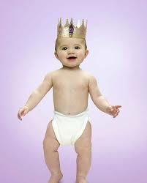
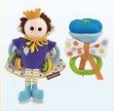
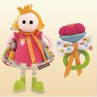
Born of Noble Birth
Typically a king or member of the royal family
Someone that normal people would “look up to” or admire – has outstanding qualities

Slide 5
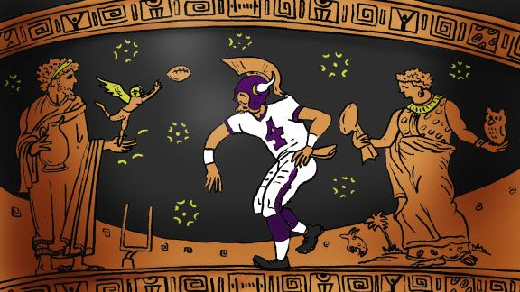
Possesses a Fatal Flaw
Also called the Hamartia
Traditional fatal flaw is hubris, or excessive pride
Flaw ultimately leads to hero’s downfall, often death

Slide 6
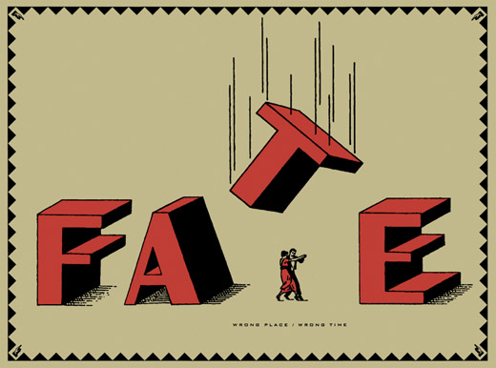
Fate is controlled by flaw
First enjoys privileged life (remember noble birth!)
Flaw causes a reversal of fortune called the Peripeteia
Ultimate fate is a downfall, often death
Downfall seems more impressive due to fall from noble position

Slide 7
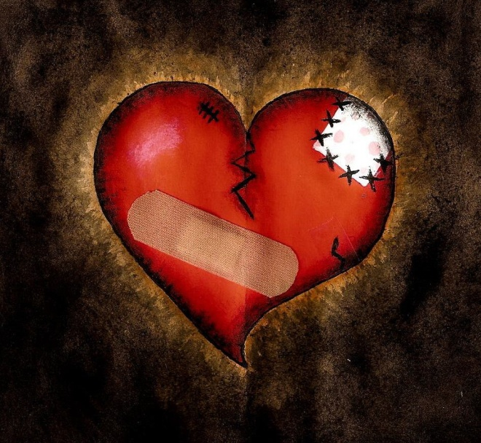
Must be physically or spiritually wounded by experiences
May be injured, or may suffer losses of family or fortune

Slide 8
Suffering has meaning
Downfall or death is usually seen as a waste of human potential
Suffering always has greater meaning, often related to the flaw

Slide 9
Downfall arouses pity or fear
Audience feels pity for hero because flaw is not his fault, so downfall seems undeserved
Audience feels fear because they can identify with hero’s thoughts and actions
“Wait…this could happen to me!”

Slide 10
CATHARSIS
When used in literature, catharsis is the the release of emotions such as pity, sadness, and fear through witnessing art. Catharsis involves the change of extreme emotion to lead to internal restoration and renewal.
The theory was that, through viewing tragedy, people learned to display emotions at a proper amount and lessen excessive outbursts of emotion in daily life.

Slide 11
Glimpse of Restored Balance
The end of the tragedy must give some sort of hope of balance or peace.
Even though terrible things have happened, something good will come out of the tragedy.

Slide 12
Tiger Woods
Noble birth: he was loved, respected, and a great athlete
Hamartia: Insatiable desire for other women
Peripetea: His cheating is found out and he is mocked in the news
Wounded: He lost his sponsorships, he was no longer respected by the people
Suffering has meaning: relates to our belief that great people should live moral lives, problems with the ideas that athletes are role models.
Catharsis: We feel satisfied when a hero falls and that justice was served.

Slide 13
Bill Cosby

Slide 14
Bill Cosby
Noble birth: he was a beloved actor
Hamartia: His desire for dominating women
Peripetea: His wrongdoings are discovered and he is put on trial
Wounded: He was no longer respected by the people and lost any reputation for acting
Suffering has meaning: Makes us aware that just because someone plays a good person on TV doesn’t equate to morality in real life.
Catharsis: We can release our anger and frustration at the fallen hero, rather than in our own lives.

