Slide 1
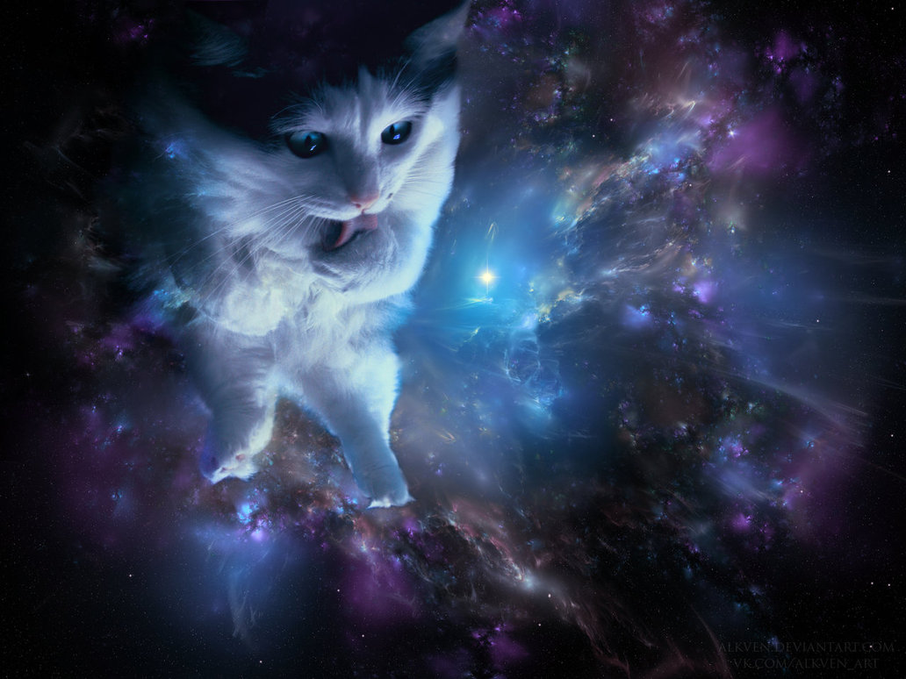
Science Fiction and Fantasy
World Building

Slide 2
Warm up
Answer the following two questions with as much detail as possible:
How is our classroom different and similar to a classroom 100 years ago?
Imagine a classroom 100 years from now. What can you imagine will be similar and what will be different?

Slide 3
All Summer in a Day
Go to the resources page on my website and find the story “All Summer in a Day”.
Read it on a laptop or on your personal device.

Slide 4
All Summer in a Day
What happened?
What elements of this world could you discern? How did you figure it out?
Does this story, and the world it reveals, seem possible?
What do you think is the larger theme of this story? What is the point?

Slide 5
Definitions
How do you define science fiction and fantasy?
What are some examples of science fiction and fantasy stories that you know of?
How are the two genres similar and different?

Slide 6
Difference between Sci Fi and Fantasy
Science fiction is always based in our world.
It has to be something that is POSSIBLE, even if it doesn’t exist yet
Fantasy always REFLECTS our world, but does not have to be based in it
Even though things are fantastic, there still must be some things that are recognizable

Slide 7
Science Fiction
By imagining what could be, science fiction offers possibilities—for the better or for the worse.
In fact, science fiction has predicted the future, and maybe even influenced the future.

Slide 8
Examine Today
Before you can predict the future, first you need to examine what is possible NOW.
Fill out the chart about technology, biology, and social trends now.
Once you exhaust your own ideas, use your devices to find some more.

Slide 9
What are some trends?
What technology, science and trends did you find?

Slide 10
Prevent and Invent!
Imagine how some of those trends/technological advances might evolve over the years.
Then, imagine what dangers might come from them that we might want to PREVENT, and what advances we might want to encourage.

Slide 11
World Building
No matter what type of story you are writing, you will need to do some world building, whether it is the type of family a character lives in, the small town vs. big city, or how his/her friend system works.
HOWEVER, science fiction and fantasy require a bit more world building since so much of the outside world is different from our own.

Slide 12
Examples
What are some movies, TV shows, or books that have worlds that are different from our own?
What are some of the major differences/similarities between these worlds and our own?

Slide 13
Different Worlds
EVERY story brings us into a world, its just the level of familiarity that changes.
For example, Criminal Minds and Scandal, both stories that exist in our overall world, reveal a whole different society than what we experience everyday.

Slide 14
Activity
Break up into groups and fill out the chart. Examine several different worlds (whose differences are based on a number of different variables) to see how each category exists, but changes from one world to another.

Slide 15
Creating your own
Brainstorm your own world. This could be the world of your novella or one altogether different.
What type of world would you want to create? Science fiction? Fantasy? Realistic?

Slide 16
Creating Your Own
Some decisions you make will greatly alter the way that your world works.
For example, what would change, or what elements would you have to consider, if your protagonist was a:
Robot?
Mermaid?
Dragon?
Clone?
Politician?
Mafia boss?

