Slide 1
Heart of Darkness
Introduction

Slide 2
The Title
What are your connections with this book and title?

Slide 3
Chapter Titles
Why do you think Conrad would break his story up into three parts? What do you think the three parts could represent?
Why do you think he does not name them?

Slide 4
Structure
FRAME STORY: this is a story that contains another story. It is the outside frame to the main story. It usually explains why the interior story is being told. An unnamed narrator begins the story on the deck of the Nellie in London on the Thames River. Be aware of every time there is a shift between this narrator and Marlow who narrates most of the story.

Slide 5
Setting and Time period
This story takes place at the end of the 19th Century (about 1890), but Marlow’s journey happened much earlier—He is telling his story, looking back on his prior experience.
Consider the description of him at the beginning: what does this imply about the story he is about to tell?

Slide 6
QUICKWRITE
Consider this word: NIGGER
How does it make you feel?
What thoughts, memories, or reactions do you have for this word?
How do you feel about its use in our modern day society? In media? In texts read in schools?

Slide 7
N* Word
Read the essay by Gloria Naylor.
Consider: How does this essay enhance or change your own perception of the word?

Slide 8
N*Word
This word is going to come up a lot in Heart of Darkness, and in some of our later texts.
As a class, how do we want to handle this word?

Slide 9
Marlow as a flawed character
Though we have two narrators in this story, the primary one is Marlow who tells his story to the unnamed narrator.
Since it is such a personal tale, it is important to make inferences as to the reliability of the character. He has flaws, even if he doesn’t recognize them.
More, he has flawed, and complicated views towards people of color. One of our goals is to discuss his complex views of race.
As a class, we need to agree ahead of time that: IN NO WAY ARE WE CONDONING RACISM OF ANY SORT.

Slide 10
Style and purpose of HOD
To begin to discuss these elements, consider Impressionist paintings. What similarities do these paintings have?

Slide 11
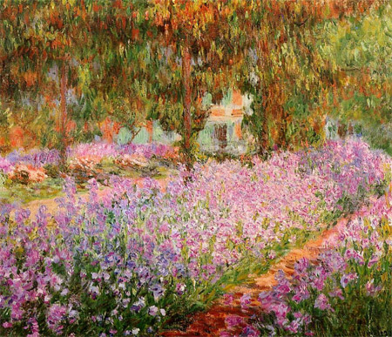

Slide 12
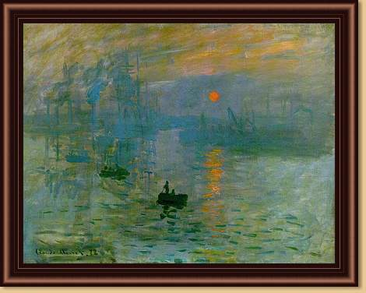

Slide 13
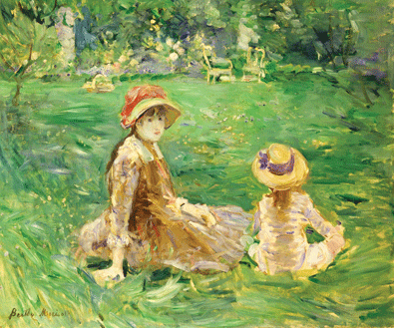

Slide 14
Why the Blurriness?
For modern novelists, the messiness and confusion and darkness of experience is interesting.
Rather than trying to simplify and abstract a particular meaning from experience, novelists tend to celebrate the multiplicity of ideas and meanings and sensations that experience can provide.

Slide 15
Why the Blurriness?
Modern novelists are in the business of recreating and communicating the rich complexities of the experience itself.
Their purpose is to get the reader to re-live an experience, with all its complexity and messiness, all its darkness and ambiguity.

Slide 16
Conrad’s world view
For Conrad, the world as we experience it is not a place that can be reduced to a set of clear, explicit truths
Instead, its truths (of the psyche, of the human mind and soul) are messy, vague, irrational, suggestive, and dark.
Conrad’s intention is to lead his readers to an experience of the “heart of darkness.”
His goal is not to shed the light of reason on it, but to recreate his experience of darkness in our feelings, our sensibilities, our own dark and mysterious hearts.

Slide 17
Consider this quote:
“But Marlow was not typical (if his propensity to spin yarns be excepted), and to him the meaning of an episode was not inside like a kernel but outside, enveloping the tale which brought it out only as a glow brings out a haze, in the likeness of one of these misty halos that sometimes are made visible by the spectral illumination of moonshine” (6).

Slide 18
What is Modernism?
Criticized the 19th century as a dangerously unreal period of comfortable certainty and positive assurance
Broke up the logically developing plot typical of 19th century novel
Attempted to use language in a new way
Drew attention to style instead of trying to make it “transparent”

Slide 19
What is Modernism?
Offered unexpected connections or sudden changes in perspective
Played with shifting and contradictory appearances to suggest the shifting and uncertain nature of reality
Used interior monologues and free association to express the rhythm of consciousness
Blended fantasy with reality while representing real historical or psychological dilemmas

Slide 20
Consider this quote
“ Romans first came here, nineteen hundred years ago—the other day…light came out of this river since—you say Knights? Yes, but it is like a running blaze on a plain, like a flash of lightning in the clouds. We live in the flicker—may it last as long as the old earth keeps rolling! But darkness was here yesterday.” (6)
What does this mean? What does this reveal about the tale that Marlow is about to tell?

Slide 21
Consider this quote
“It was the farthest point of navigation and the culminating point of my experience. It seemed somehow to throw a kind of light on everything about me—and into my thoughts. It was somber enough too—and pitiful—not extraordinary in any way—not very clear either. No, not very clear. And yet it seemed to throw a kind of light.”

Slide 22
Consider this quote
“I got my appointment…[because] one of their captains had been killed in a scuffle with the natives…It was only months and months afterwards…that I heard the original quarrel arose from a misunderstanding about some hens. Yes, two black hens. Fresleven…thought himself wronged somehow in at he bargain, so he went ashore and started to hammer the chief of the village with a stick. Oh, it did not surprise me in the least to hear this, and at the same time to be told that Fresleven was the gentlest, quietest creature that ever walked on two legs. No doubt he was; but he had been a couple of years already out there engaged in the noble cause, you know, and he probably felt the need at last of asserting his self-respect in some way.”

Slide 23
Consider this quote
“In a very few hours, I arrived in a city that always makes me think of a whited sepulchre. Prejudice no doubt.”

Slide 24
Activity
On the handout, I have listed several thematic topics, issues, and motifs that exist in Heart of Darkness. Keep an eye out for passages that relate to these ideas so that you can start to develop themes.

